Slide 1
Software Design and Analysis CS-3004
Dr. Ejaz Ahmed,
Mr. Majid Hussain

Slide 2

Contact Details
Dr. Ejaz Ahmed
Email: ejaz.ahmed@nu.edu.pk
Office: Room (C-203E, 2nd Floor Computer Science Block C), Ext 634
Mr. Majid Hussain
Email: majid.hussain@nu.edu.pk
Office: Room (D-110C, 1st Floor Computer Science Block D)
Miscellaneous
Office Hours: Will be Displayed outside my office.
2 Classes of 1.5 hours each

Slide 3
About Me, Dr. Ejaz Ahmed
Associate Professor
Education
PhD(CS) – University of Bedfordshire, UK
Research Area – Databases, Software Architecture, Data Mining, IS
MS(CS) – Coventry University, UK
MPhil: Quaid-E-Azam University, Islamabad
MSc(Maths) – Punjab University, Lahore
Teaching Experience - NU-FAST, Islamabad (2012)
Database Systems, Software Engineering, Data Warehousing, Programming Fundaments, Object Oriented Analysis and Design(OOAD)
Industry Experience - (15 years)
PRAL, Saudi Aramco, GlaxoSmithKline (GSK Canada), Delano Tech Canada
Technical Project Manager, Team Lead, Principal/senior software engineer
C++, Oracle, JavaScript, SAP, VB

Slide 4
Outline
Introduction to the Course
Course Objectives
Why this course is important for you?
Course Contents and Structure
Course Project

Slide 5
Course Structure
Follow Course Outlines/ Syllabus NCEAC format
3 Credit Hour Course (More applied than you think)
No labs
Programming Language and Tools
Java
UML Case tools like Enterprise Architect, Papyrus, draw.io etc.
Course Project
Vital and major component of the course
Group of (2) students
Weekly Task
Coding Tasks
Book Reading/ Self studying topics - Quizzes

Slide 6
Textbooks and Supplementary Reading List
Text Book(s)
Craig Larman, Applying UML and Patterns, 3rd edition, 2004.
Bernd Bruegge, Allen H. Dutoit, Object-Oriented Software Engineering, using UML, Patterns, and Java.
UML 2 Toolkit Published by Wiley Publishing, Inc.
UML 2.0, Documentation:www.rational.com
Additional Reading List
Unified Modeling Language: Superstructure, version 2.1.2, formal/07-11-02, OMG, www.omg.org
Available in the Library/E-Book

Slide 7





Software use during this course
UML (Designing/Modelling Standard)
Papyrus (Design/Modelling tool)
Enterprise Architect(Design/Modelling tool)
Draw.io(Design/Modelling tool)
Eclipse IDE (Java Development IDE)

Slide 8
Some Rules
Raise your hand before asking any question
Don’t miss a class
No retakes (except for Mid or Final Exam)
Don’t “sleep” in the class
You might miss a quiz ☹
Avoid using mobile phone in the class
Above all, whatever you do, please do not disturb others

Slide 9
Attendance Policy
Attendance will be taken at the beginning of the lecture
80% attendance is mandatory
Students coming late will be marked as late
2 late arrivals are equal to an absent

Slide 10

Dishonesty, Plagiarism
All parties involved in any kind of cheating in (Quizzes, Assignments & Projects) will get ZERO in that exam
Plagiarism in midterm/ final exam may result in F grade in the course
Habitual cases will be awarded F

Slide 11
Google Classroom Code
jskxdtai

Slide 12
Lecture Format
Start with Q & A
Main Lecture
No short breaks in the middle
Practice sessions on various case studies
Designing/Modelling of software artifacts
Translation of design artifacts into code

Slide 13

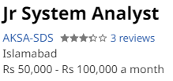
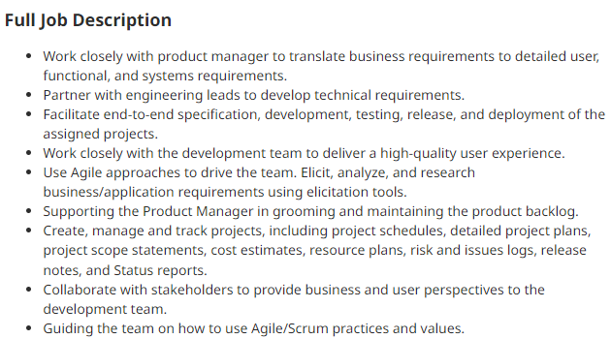
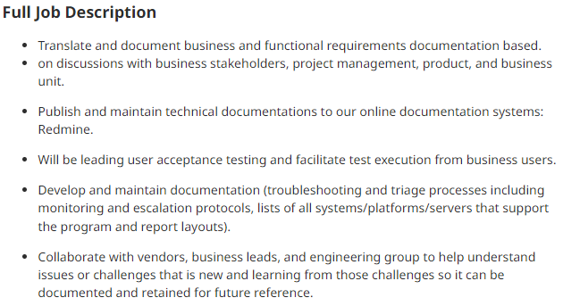
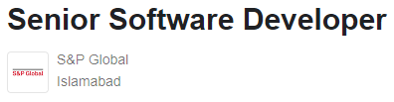
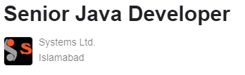
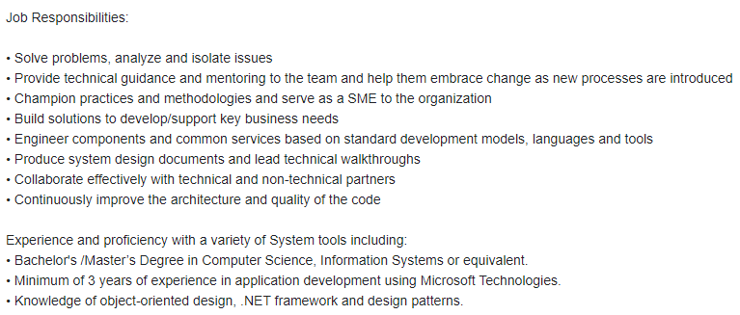
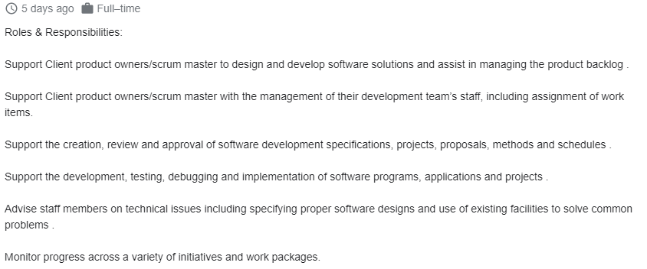
Why this course is important for you?
Provide you with skills needed to get good jobs

Slide 14
Why this course is important for you?
Almost every large and complex industrial project follow a detailed design.
Every safety critical system must be well designed according to their safety standards.
Industry hires requirement/ business analysts and software designers to model the ongoing projects.
Design artifacts carry a major weightage in FYP.

Slide 15
What is Software Analysis?
Analysis emphasizes an investigation of the problem and requirements, rather than a solution.
For example, if a new online trading system is desired, how will it be used? What are its functions?
"Analysis" is a broad term, best qualified, as in requirements analysis (an investigation of the requirements) or object-oriented analysis (an investigation of the domain objects).
First time requirements from scratch or requirements of an existing system (enhancements)
Notes:
It means carefully studying the problem to understand:
What is the actual problem?
What are the requirements or constraints?
What resources are available?
What approaches or algorithms can be applied?
Steps in Problem-Solving Investigation:
Problem Understanding – Define the problem clearly (what is being asked?).
Gather Information – Collect data, requirements, and constraints.
Break Down Problem – Divide it into smaller, manageable parts.
Explore Possible Solutions – Brainstorm different strategies.
Choose Best Solution – Select based on efficiency, feasibility, and resources.
Plan Implementation – Prepare algorithms, flowcharts, or design.
Test & Validate – Check if the solution really solves the problem.

Slide 16
What is Software Design?
Design emphasizes a conceptual solution (in software and hardware) that fulfills the requirements, rather than its implementation.
For example, a description of a database schema and software objects.
Design ideas often exclude low-level or "obvious" details—obvious to the intended consumers.
Design can be implemented, and the implementation (such as code) expresses the true and complete realized design.
Civil Architect prepares a design of building, houses, dams, bridges etc. Other Designs can be nuclear power plants, Electrical and Electronics etc.
What is a System?
Notes:
High level abstract model of the system
Conceptual design is the abstract model that describes the system in terms of concepts, entities, relationships, and high-level processes.
It focuses on what the system is and what it must achieve, not on programming details, hardware, or actual implementation.
Abstract → Does not include technical details.
User-oriented → Describes the system from the user’s or business perspective.
Platform-independent → Can be implemented in any programming language, database, or technology later.

Slide 17
Useful analysis and design have been summarized in the phrase
do the right thing (analysis), and
do the thing right (design).

Slide 18
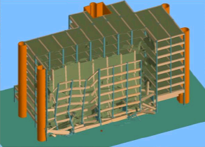
What if we do not follow Design?

Slide 19
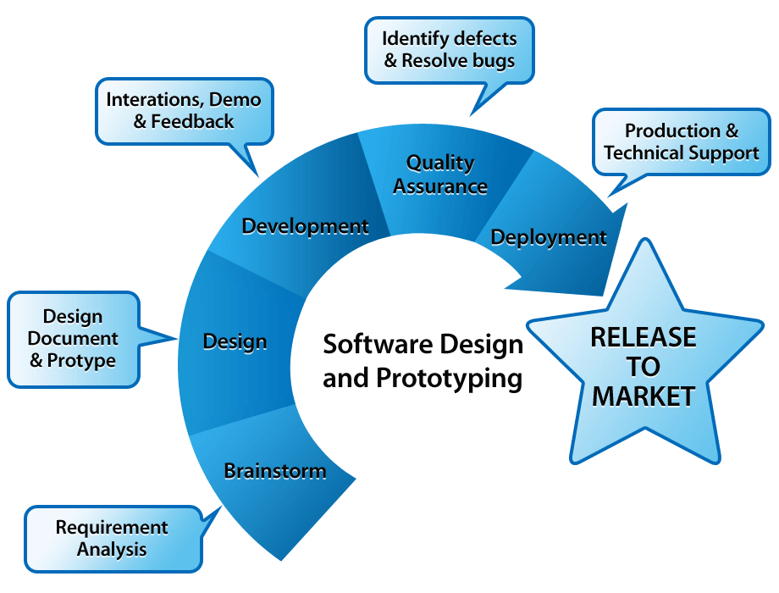
Software Development Process

Slide 20
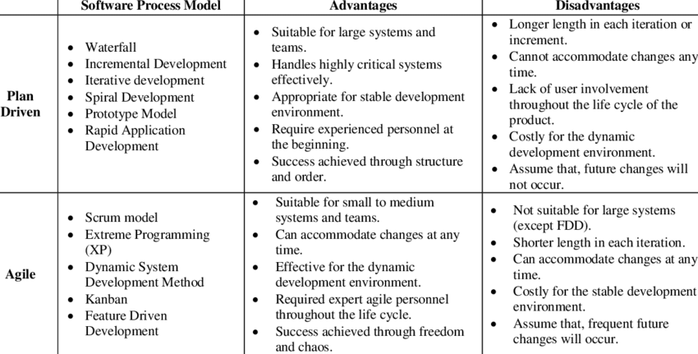

Slide 21
Traditional Software Development Flow
When a software developer begins work with a new project, it's natural for him to choose to commence scripting the code immediately.
Regardless of his software knowledge, if someone produces software without laying out a strategy for it, he might as well have been laying bricks without establishing a solid foundation.
The building will fall no matter how robust the construction process and resource consumption are; similarly, the software would fail without a fundamental layout.
Nobody wants their efforts to be for waste because they didn't have a plan for them, right? That's where software design comes in, a mechanism that simplifies important software operations in a certain way.

Slide 22
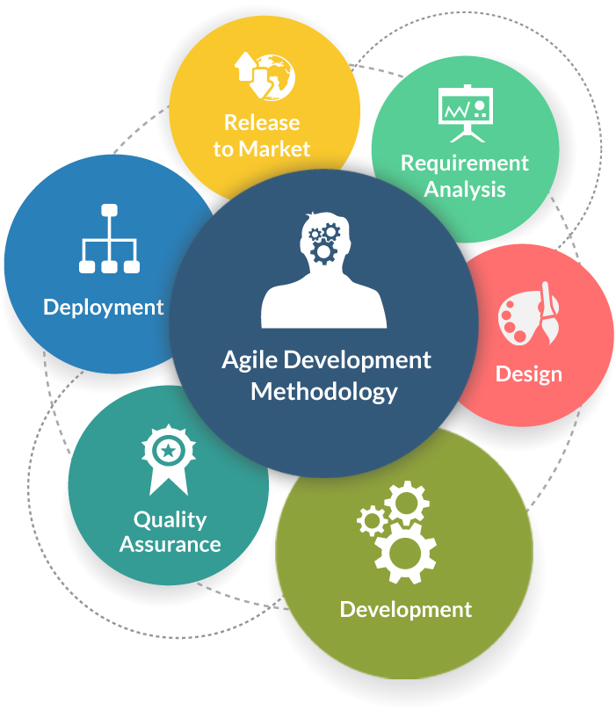
Software development Methodologies
frequent alteration in the development project
minimize risk by developing software in short time boxes
changing requirements of the clients.
Notes:
Reference link: https://www.tatvasoft.com/blog/top-12-software-development-methodologies-and-its-advantages-disadvantages/

Slide 23
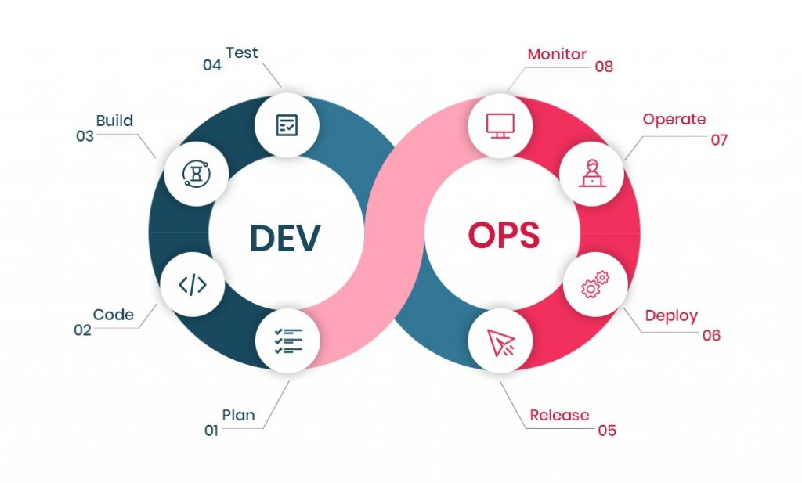
Cont..
Follow continuous integration and continuous delivery model
development and operational teams to perform everything simultaneously in development, quality assurance, security, and other operations.
It makes the process faster and easier for businesses to process on time

Slide 24
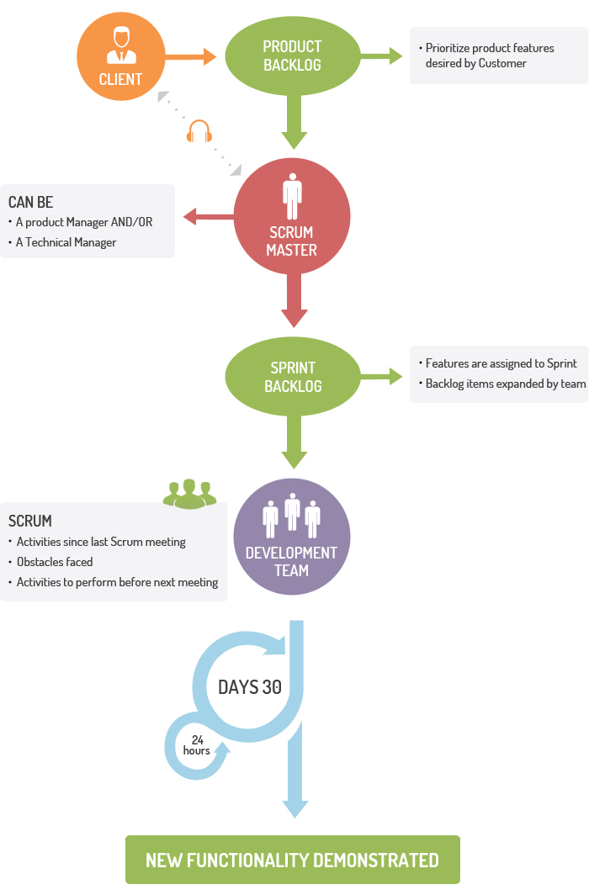
Cont..
For companies where the requirements are highly emerging and rapid changes are easily adhered to.
daily meeting easily helps the developer to make it possible to measure individual productivity.
Due to short sprints and constant feedback, it becomes easier to cope with the changes

Slide 25
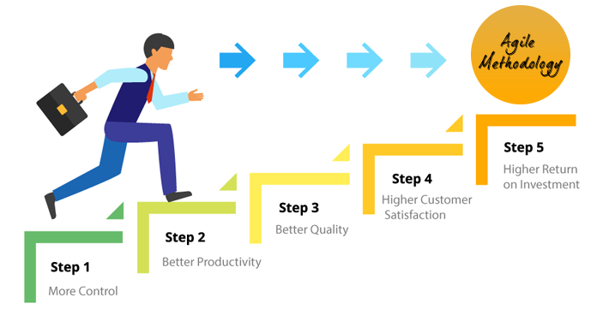

Slide 26
Introduction to the Course
A major engineering problem today
Predictable development of reliable software systems.
The object-oriented paradigm
solutions to many development problems
provides a reliable design, complexity control, and reusability
Object-oriented methods can be divided into analysis and design, implementation languages, and distribution
Basic to the entire enterprise, however, are analysis and design, which has remained remarkably stable for years.
Object-Oriented Analysis and Design
overall goals of the object paradigm, the selection of classes, the relationships among them, and their realization to implement systems
Notes:
Software reliability is the probability of failure-free operation of a computer program for a specified period in a specified environment

Slide 27
Unified Modeling Language
A de facto industry standard by the Object Management Group (OMG)
Standard language for specifying, visualizing, constructing, and documenting the artifacts of software systems, business modeling and other non-software systems.
The UML represents a collection of best engineering practices that have proven successful in the modeling of large and complex systems.
The UML is a very important part of developing object oriented software and the software development process.
The UML uses mostly graphical notations to express the design of software projects.
Using the UML helps project teams communicate, explore potential designs, and validate the architectural design of the software.
Notes:
The goal of the OMG was a common portable and interoperable object model with methods and data that work using all types of development environments on all types of platforms.

Slide 28
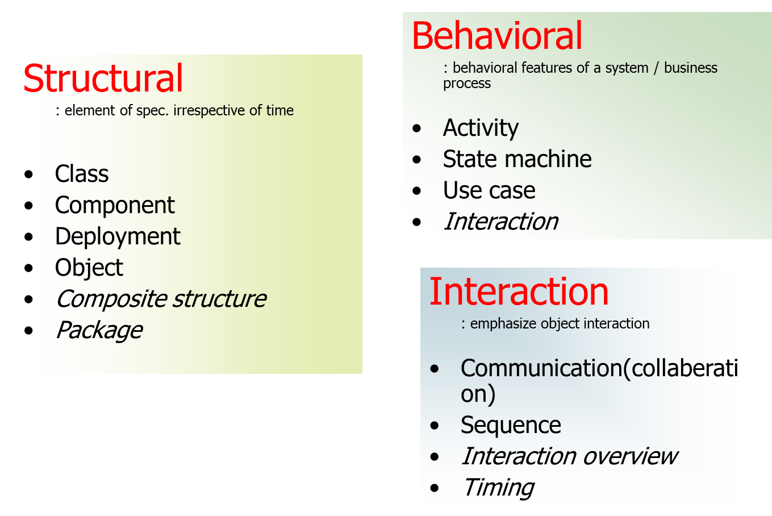
Overview of UML Diagrams
emphasizes the static structure of the system using objects, attributes, operations and relationships.
emphasizes the dynamic behavior of the system by showing collaborations among objects and changes to the internal states of objects.

Slide 29
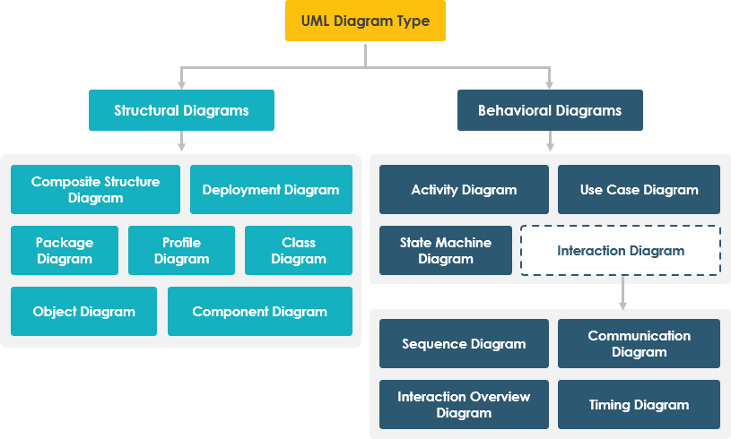

Slide 30
COURSE PROJECT
Should be MIS

Slide 31
SW Development Project: Deliverable 1
1 | APEX
2 | SYNOPSIS
3 | Chimera Soft
4 | LOGIX
5 | Envision Tech
6 | HEDZ
7 | Consumate Logiciels
8 | Logistics
9 | ATEK Inc
10 | Pi Sigma
11 | Erap Solutions
12 | Mantaq Solutions
13 | Design Minds
14 | Dream Technologies
15 | Logic All
16 | Synergy
17 | Solution Providers
18 | Ferocity Inc
19 | Cryph Tech
20 | COGILENT
Deliverable #1:
Deadline: (Announced later)
COMPANY
Company Name (of your newly established company)
Company Logo
TEAM (3) Members
(Team) Manager
(Requirement) Analyst
Manager QA
Designer
Developers/SW Engineers

Slide 32
SW Development Project: Deliverable 2
Deliverable #2
Project Selection
Meeting with the client
Project Proposal
Present the idea of the project and what is aimed to achieve
Sections
Project Title
Scope
Objectives
Problem Statement and Description

Slide 33
Project Proposal Components
Title
Should be well defined Indicate the project aim and immediate solution its going to provide.
Scope
Defines the domain of the project. List any previous tools or work done in the same area. Also identify the level to which the project is going to be probed into in future.
Objective
Outline the major aims/goals that are aimed to be achieved through the project
Problem Statement and Description
Explain the major reason for choosing the project and the problem addressed by the project. Describe the problem in detail ( e.g. office automation mitigates manual work etc)
Should not be more than 2-3 paragraphs
Can also explain Feasibility.

Slide 34
SW Development Project: Deliverable 2
Deadline: Announced later
Project Title
Scope
Objectives
Problem Statement and Description
Project Proposal and other deliverables (to be explained later on by Course Instructors and LI’s)
Deliverable format : Found in course book, explained by course instructor OR explained in the assignment description.
If in doubt, YOUR responsibility to ask AHEAD of deadline, not ON or AFTER IT!

Slide 35
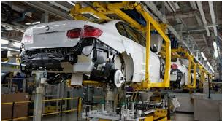


What is a System?
A system is a group of elements that are integrated with the common purpose of achieving objectives
Notes:
Academic System Flex, ATM, Air Reservation System
System should be full of relevant information for you
Involve yourself in a system, feel, observe and analyze about it.
How booking is managed?
How treatments, diagnosis and issue medicines are managed?
How manufacturing status is monitored?
System is a set of methods, procedures, practices and technology

Slide 36
System with Information
System is a set of methods, procedures, practices and technology.
Business need means: In academic system, students need to view their own grades, marks and transcript. Status of registration, offered courses etc.
What kind of system has less information?
Notes:
Methodologies for getting information can be Waterfall Model, Agile Development, Object Oriented Approach, ER-Design, ERP etc.

Slide 37
Need for information
Businesses require decisions
Decisions require information
Nature of information varies with the nature of business and decision
Planning for business requires information at regular interval
Create processes, Store data/ information, Search data, Summarize Data, Control data (rules/ best practices), Access information
Notes:
A System is introduced in some organization, Information need to be implemented by flowing information

Slide 38
What is Information System (IS)?
Interrelated components are working together to collect, process, store and disseminate information
Every information does not go to every body
ESS, DSS, MIS, KWS, OLTP
Notes:
COE does not have time to see information such as all invoices
Director does not need list of vouchers of fee of every student. Director only need total fee collected for a particular semester. He may need comparison values
Information about Customer, Supplier, Accounting, Grading etc.
ESS: Executive Support system,
DSS: Decision Support System
KWS: Knowledge Work System
OLTP: Online Transaction Processing
Search for CS507 online lecture about IS

Slide 39
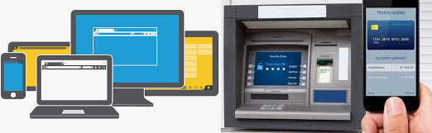
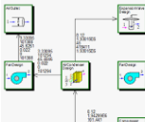
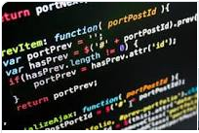

Artifacts for IS?
Web & GUI
Designing/ Modeling
Coding/ Programming
SQL Programming
Database (Data Storage)
Notes:
Can we say DB system lies under principles of IS?

Slide 40
Attributes of IS
Easily Availability
Timelines
Relevant to decision at hand
Related to current business needs
Notes:
Timelines: On time, without delay
Information are relevant to your need. From Academic system, salary details cannot be obtained
Take the decisions to lowest level, why a data entry operator enters data for higher management. Entering attendance for exam sittings
Global Village: Business need. Place an order on internet and get pricing, then goods are delivered to me from abroad seamless. Information are passed on very frequently.
Find the status of order online-automated
Business need means: In academic system, students need to view their own grades, marks and transcript. Status of reg, offered courses etc.

Slide 41

Thanks

